Slide 1



Web Development
Fundamentals
Session – 1
By
Surekha R
Technical Trainer

Slide 2




Web Development Fundamentals
Browser & URL - It is Must - to open any website
Syntax – Rules of the Language – A small part of programming
Bug & Debugging – Making your code work
One of the important parts of programming
Tweaking Code – Getting insights into code

Slide 3

Websites

Slide 4
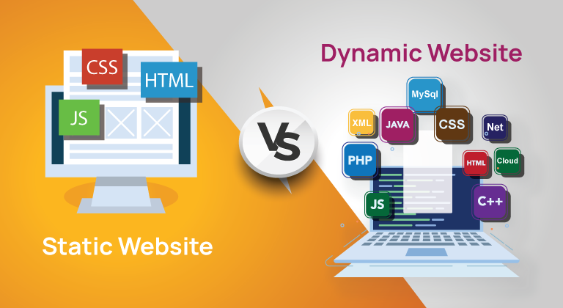

Types of Websites

Slide 5
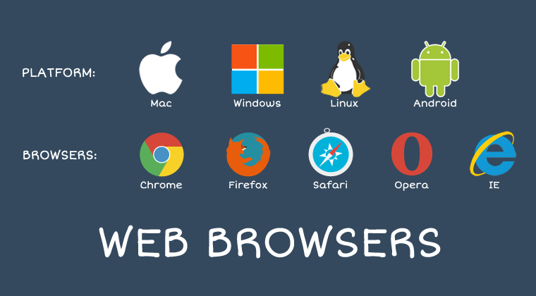
Browser

Slide 6
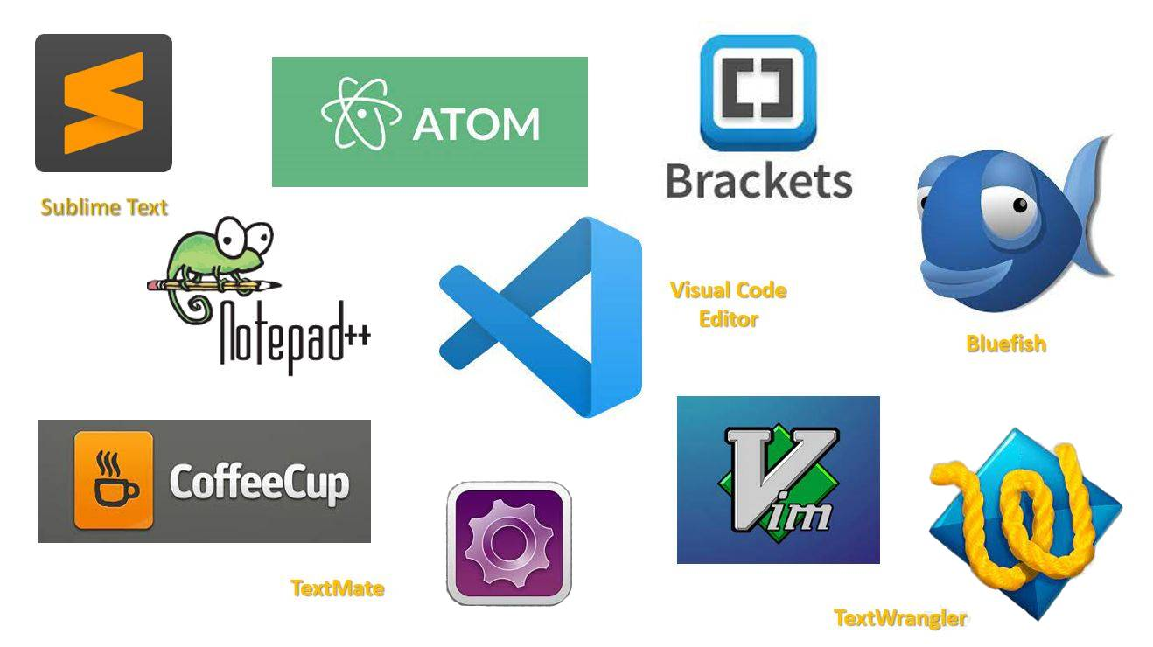
TEXT EDITORS

Slide 7
Tools for Website
HTML
CSS
Bootstrap
JavaScript

Slide 8


Static Websites

Slide 9

Responsive Websites

Slide 10

Dynamic Websites

Slide 11
HTML
HTML is the standard markup language for creating Web pages.
HTML stands for Hyper Text Markup Language.
HTML describes the structure of Web pages using markup.
HTML elements are the building blocks of HTML pages.
HTML elements are represented by tags.
HTML tags label pieces of content such as "heading", "paragraph", "table", and so on
Browsers do not display the HTML tags but use them to render the content of the page.

Slide 12
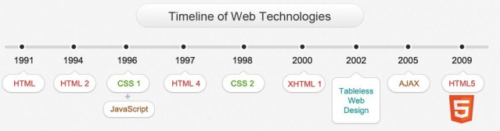
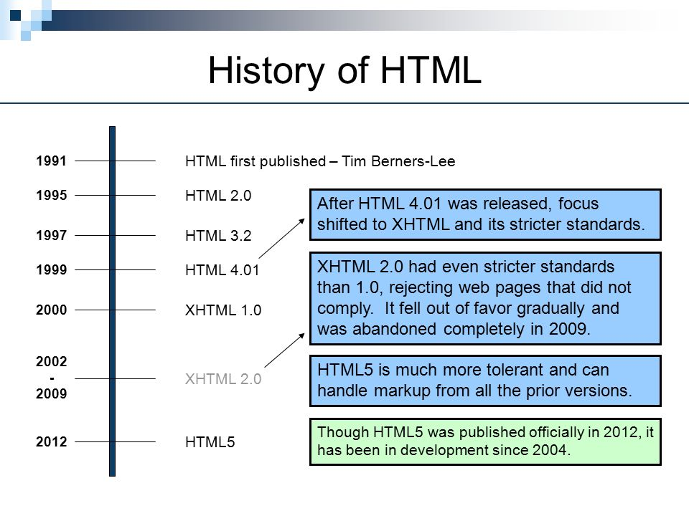

Slide 13
HTML
The <!DOCTYPE html> declaration defines this document to be HTML5
The <html> element is the root element of an HTML page
The <title> element specifies a title for the document
The <head> element contains meta information about the document
The <body> element contains the visible page content
The <h1> element defines a large heading
The <p> element defines a paragraph

Slide 14
HTML Tags
HTML tags are element names surrounded by angle brackets:
<tag name>content goes here...</tag name>
HTML tags normally come in pairs like <p> and </p>
The first tag in a pair is the start tag, the second tag is the end tag
The end tag is written like the start tag, but with a forward slash inserted before the tag name

Slide 15
Anatomy of an HTML element
Container Element - An element that can contain other elements or content.
    A paragraph (<p>content</p>) contains text
Stand Alone Element - An element that cannot contain anything else.
    <br>, <img>

Slide 16
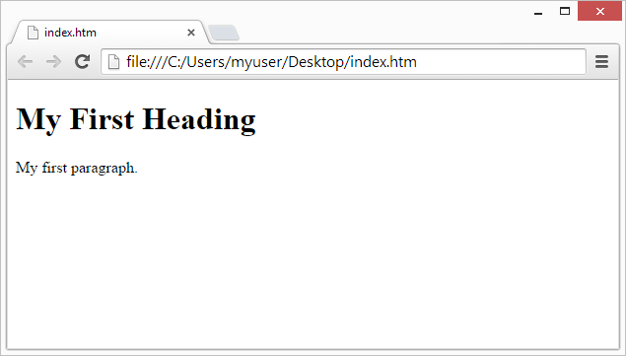
Web Browsers
The purpose of a web browser (Chrome, IE, Firefox, Safari) is to read HTML documents and display them.
The browser does not display the HTML tags, but uses them to determine how to display the document:

Slide 17
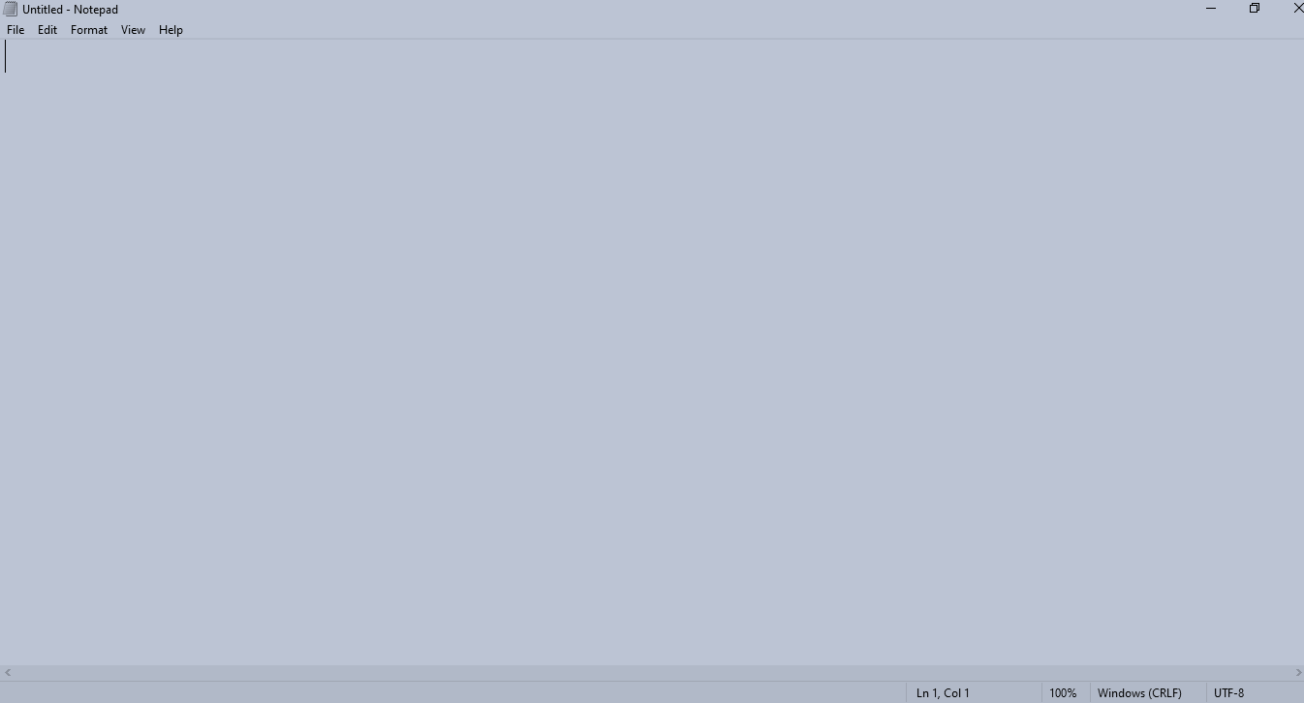
Text Editors
Notepad

Slide 18
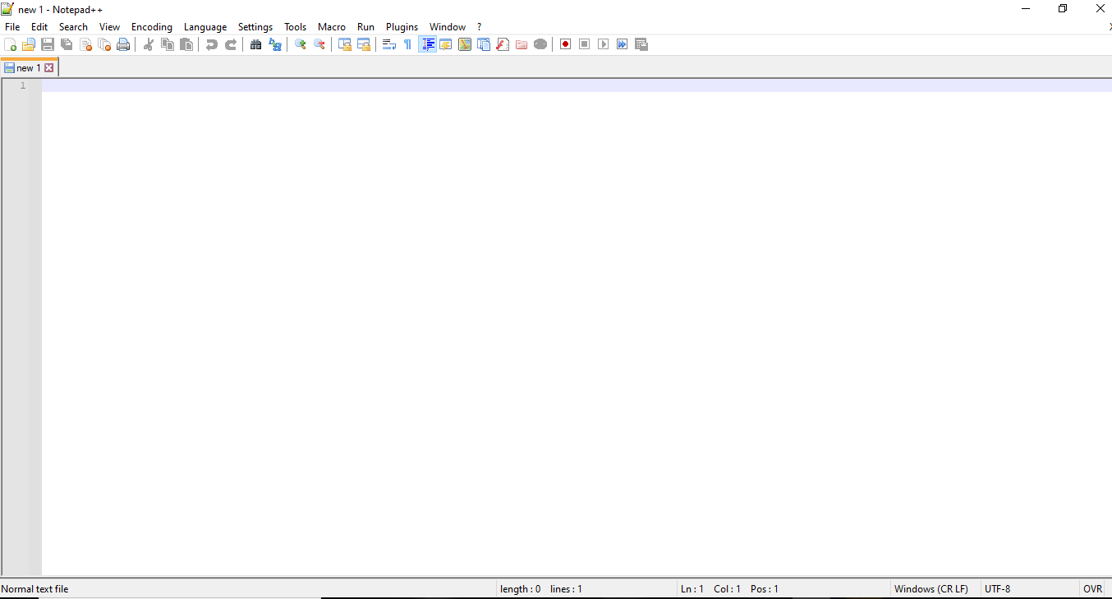
Notepad ++

Slide 19
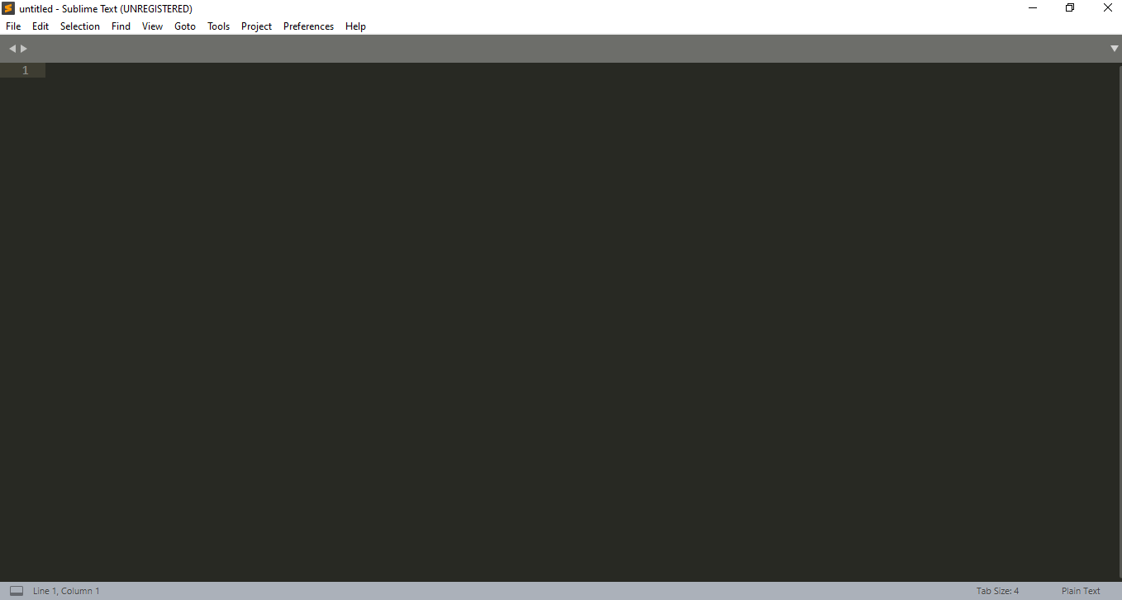
Sublime Text Editor

Slide 20
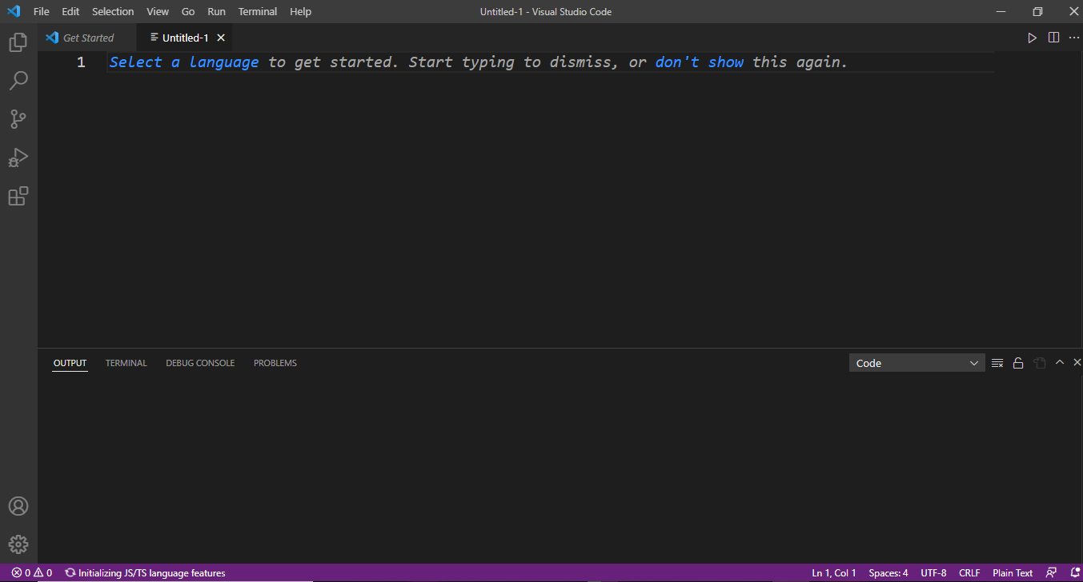
Visual Studio Code

Slide 21
How to Run the HTML Program in NOTEPAD
Start 🡪 Open Notepad
File 🡪 New ( ctrl + N)
Type a code
To create a new folder ( C Drive (or) D Drive ..etc)
File 🡪 Save ( ctrl + S) To Save a Program eg: sample.html
How to run a Program
Select the File directory copy than open the browser( Chrome ,IE …etc) Paste the Directory

Slide 22
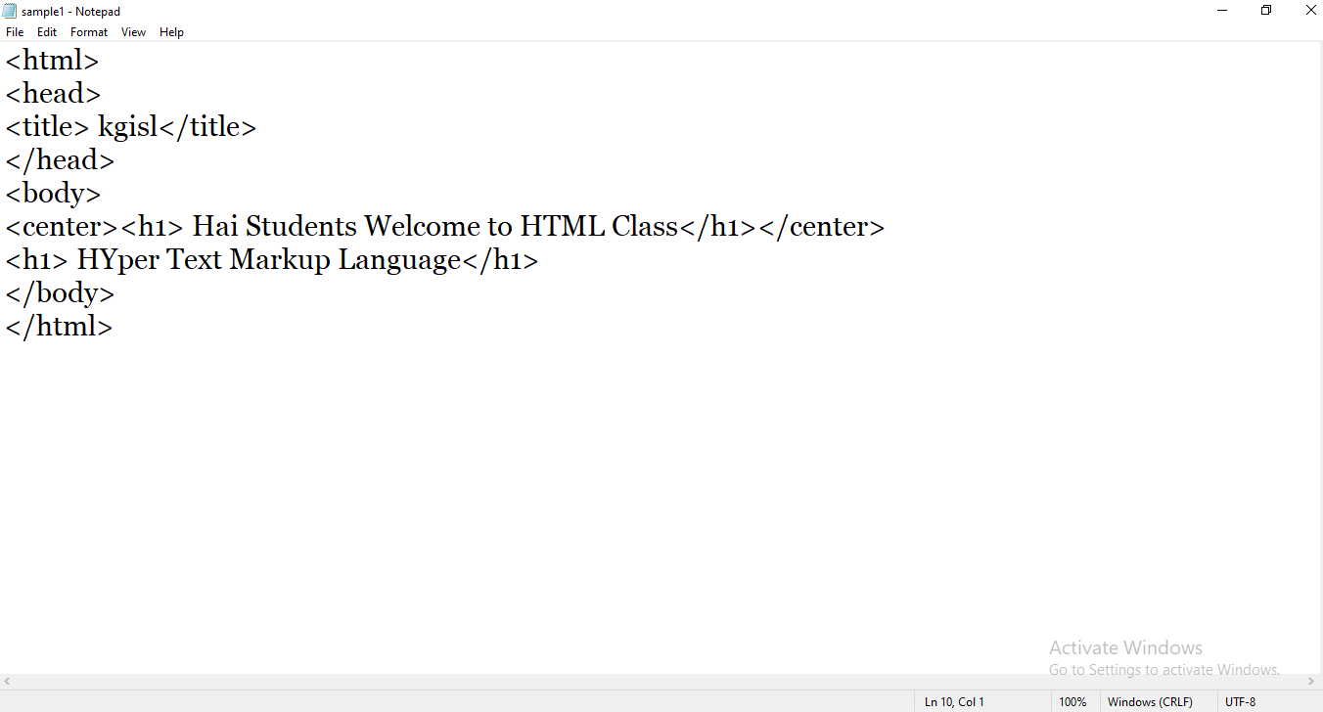

Slide 23
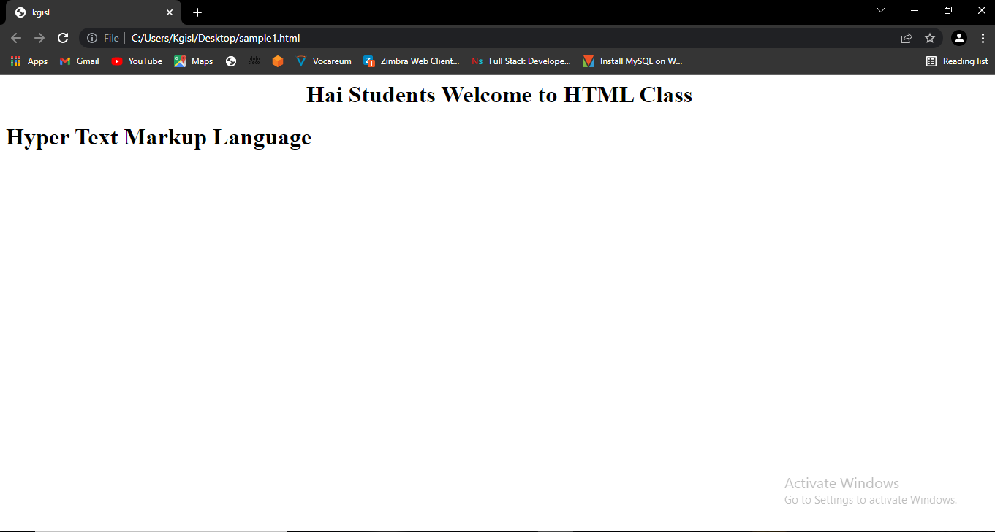
OUTPUT
Title tag
File Path
Body tag

Slide 24
How to Run the HTML Program in NOTEPAD++
Start 🡪 Open Notepad++
File 🡪 New ( ctrl + N)
Type a code
To create a new folder ( C Drive (or) D Drive ..etc)
File 🡪 Save ( ctrl + S) To Save a Program eg: sample.html
How to run a Program
View menu 🡪 View Current File in(Chrome , IE ..etc)

Slide 25
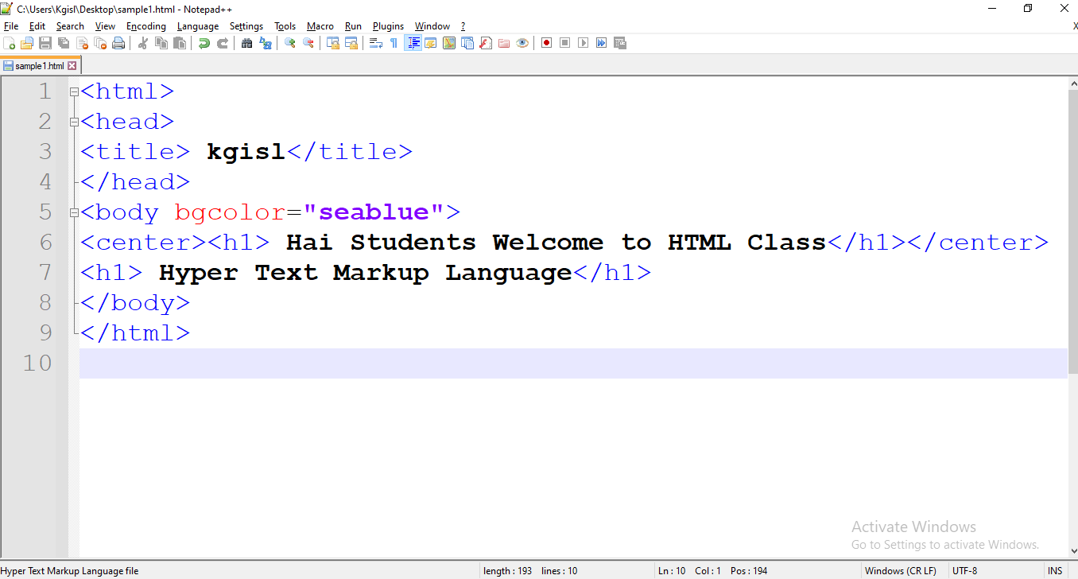

Slide 26
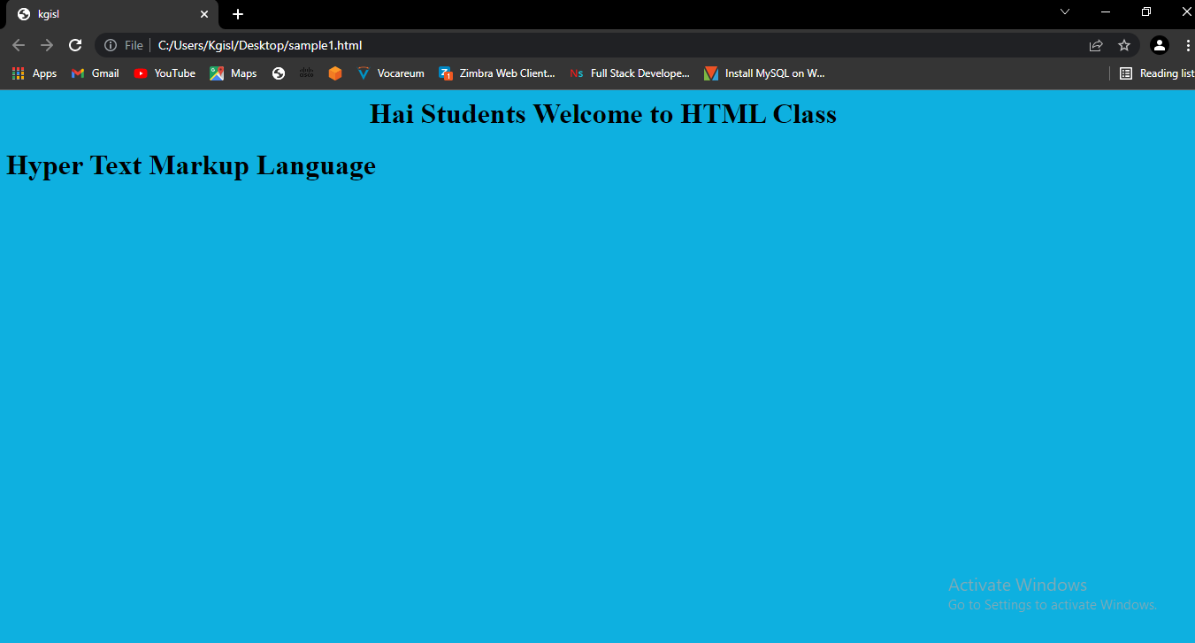
OUTPUT

Slide 27
How to Run the HTML Program in Visual studio code
Start 🡪 OpenVisual Studio Code
File 🡪 New ( ctrl + N)
Type a code
To create a new folder ( C Drive (or) D Drive ..etc)
File 🡪 Save ( ctrl + S) To Save a Program eg: sample.html
How to run a Program
Run Menu 🡪 Run with Debugging than Choose Browser

Slide 28
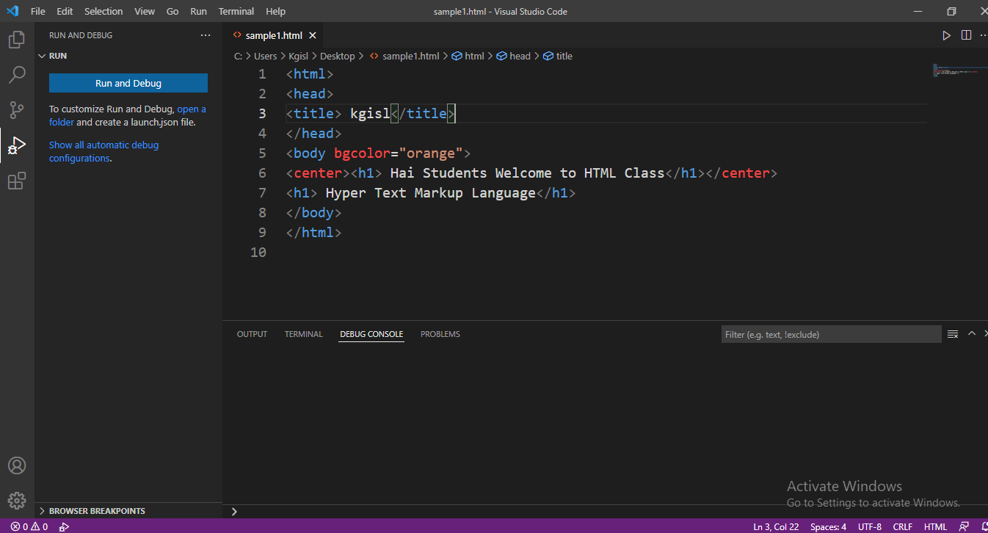

Slide 29
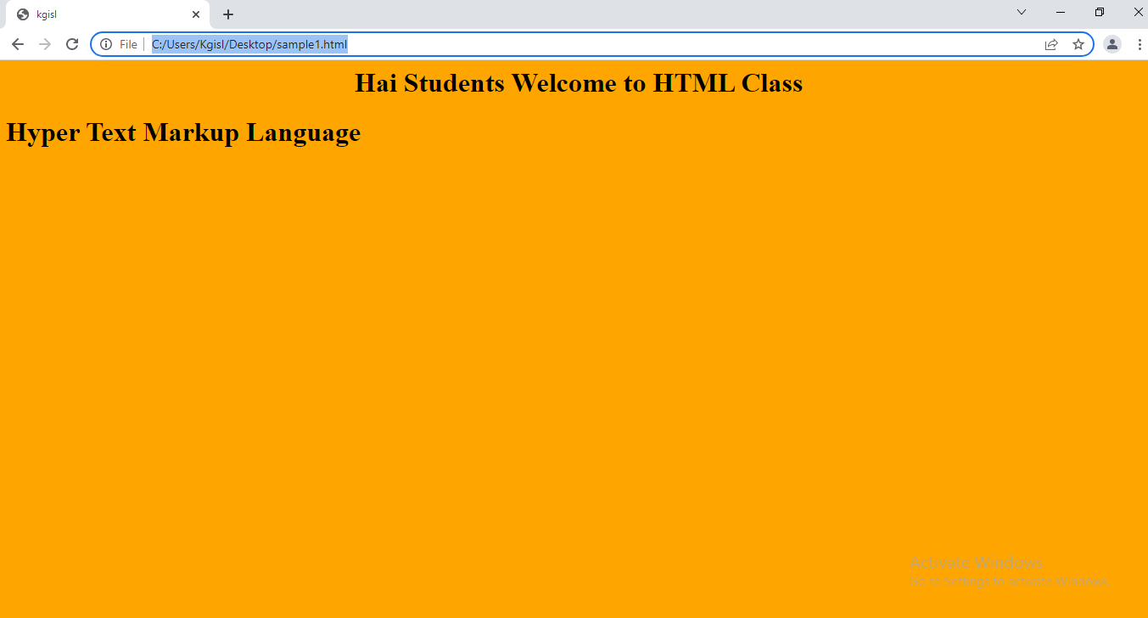
OUTPUT

Slide 30
How to Run the HTML Program in Sublime Text Editor
Start 🡪 Open Sublime Text Editor
File 🡪 New ( ctrl + N)
Type a code
To create a new folder ( C Drive (or) D Drive ..etc)
File 🡪 Save ( ctrl + S) To Save a Program eg: sample.html
How to run a Program
Program body 🡪 right click 🡪 Open in Browser

Slide 31
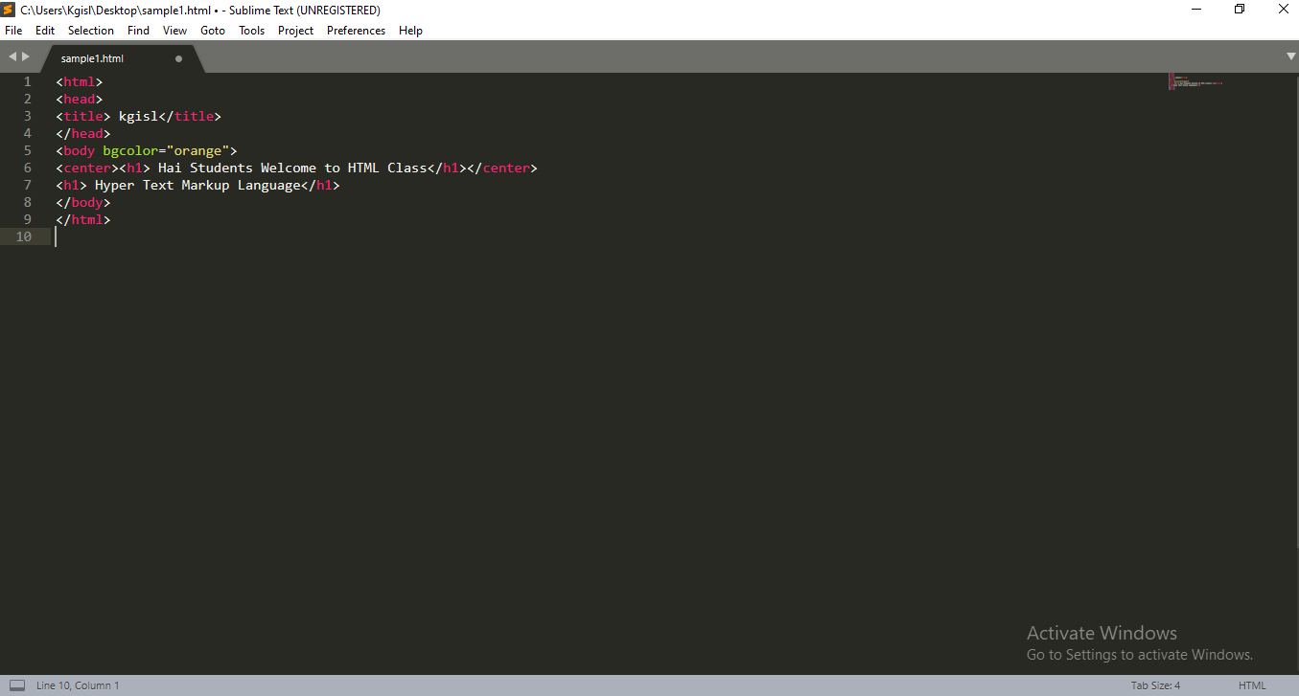

Slide 32
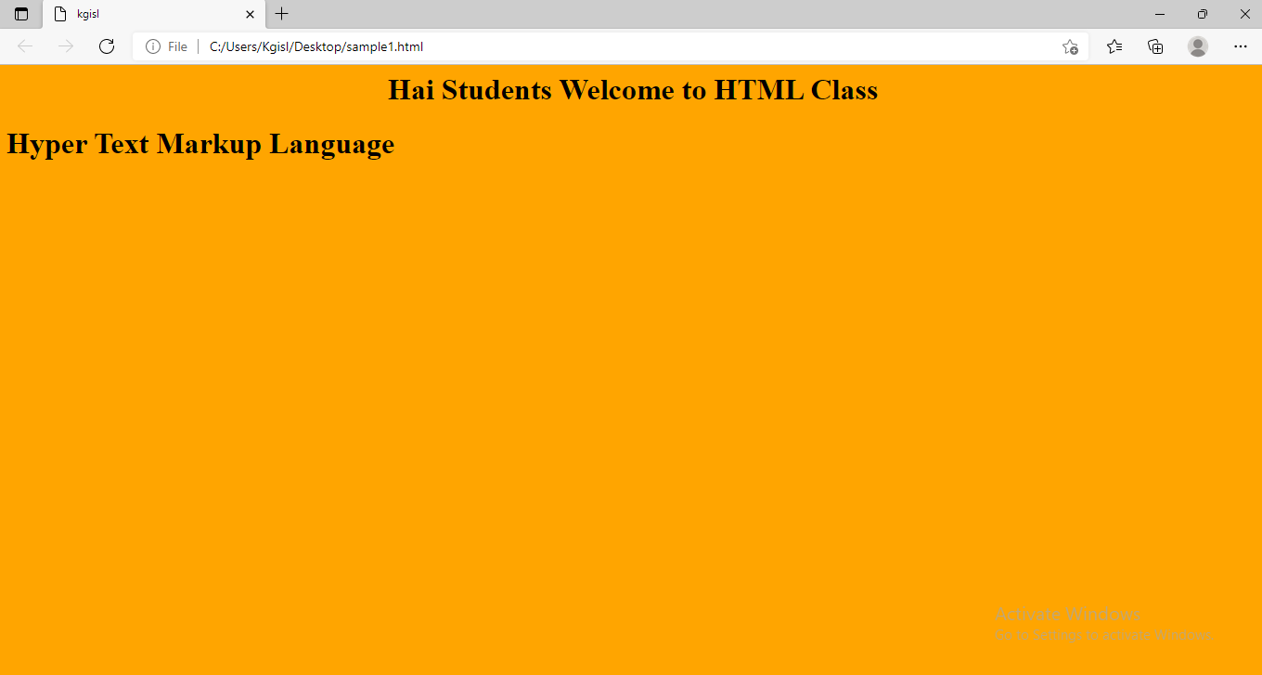
OUTPUT

Slide 33
What is a HTML 4 ?
HTML 4 is a markup language that was published in 1997 as a W3C Recommendation. HTML 4 is an extended version of HTML 3.2.
It is a revision of the previous HTML and supports various features like a scripting language, style sheets, embedding objects, richer tables, object support, and other advanced accessibility features with special users who have a disability.

Slide 34
HTML Basic Structure
Below is a visualization of an HTML page structure:
<html>
<head>
<title>Page title</title>
</head>
<body>
<h1>This is a heading</h1>
<p>This is a paragraph.</p>
<p>This is another paragraph.</p>
</body>
</html>

Slide 35
What is a HTML 5 ?
HTML is the fifth and the latest major version of HTML that is a WWW Consortium (W3C) recommendation. It was released on 22nd Jan 2008.
The objective of the new version was to support the latest multimedia and bring forth other new features. The language become easy and could be easily read by humans and integrated into computers and devices.

Slide 36
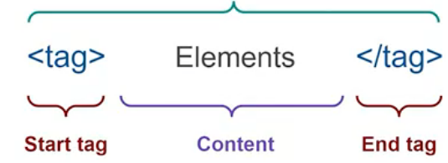
Structure of an HTML5 Document
<!DOCTYPE HTML>
<html lang=“en”>
<head>
<meta charset=“utf-8”>
<title>Document title goes here </title>
</head>
<body>
<h1>Main heading goes here</h1>
<p>Paragraph content goes here</p>
</body>
</html>

Slide 37
<!DOCTYPE>
Doctypes – short for “Document type” – helps browsers to understand the version of html the document is written in for better interpretability.
Doctype declarations are not html tags and belong at the very top of a Document.
Syntax:
<!DOCTYPE html>

Slide 38
<html lang=“ ”>
The HTML page content must be contained between <html> tags, So that the browser can recognize it as HTML document.
<html lang=“en”> The lang attribute specifies the language of the elements content.
Ex-”en” for English, ”es” for Spanish, “fr” for French and so on.
Syntax:
<html lang=“en”> Your code goes here
</html>

Slide 39
<head>
The head contains the title of the page and information about the page.
Syntax:
<head> Your title and info goes here </head>

Slide 40
<meta charset=“utf-8”>
Gives the browser some metadata about the document.
The charset attribute declares the character encoding.
Modern HTML documents should always use utf-8.

Slide 41

Keep All in Mind
And
Create Your Own Website

